Slide 1
Northeast Convective Flash Floods: Helping Forecasters Stay Ahead of Rising Water
Joe Villani - National Weather
Service, Albany, NY
Derek Mallia - University at Albany
ER Flash Flood Conference – June 2-4, 2010

Slide 2
Goals
Better anticipate meteorological environments that produce flash flooding (FF)
Forecast “watch” phase of a FF event (12-24 hours in advance)
Identify factors that may distinguish days with isolated vs. widespread FF

Slide 3
Methodology
Investigated 39 FF events from Albany County Warning Area (CWA)
Warm season events from 2003 through 2009 (non-tropical)
Classified events based on type of dominant feature when FF occurred

Slide 4
Methodology
Compiled sounding derived parameters for each event
Entered data in spreadsheet
Stratified data based on isolated vs. widespread events

Slide 6
Methodology
Isolated = FF occurring over a small area resulting from one cluster of convection
Widespread = FF occurring over a large (or multiple) area(s) resulting from several clusters of convection

Slide 7
Methodology
Composite plots of synoptic scale features using CDC website
Compared composites for days with widespread vs. isolated FF
Signatures evident in:
500 hPa height anomalies
850 hPa meridional wind anomaly
250 hPa zonal wind mean

Slide 8
Data Sources
Weather Event Simulator (WES)
Archived local AWIPS data
Radar, satellite, surface observations, observed soundings, model initialized soundings
Soundings from 12 UTC or 18 UTC
Times preceded FF occurrences
Data mainly from ALB, some OKX

Slide 9
Sounding Derived Indices Averages for all FF events
CAPE | 938 J/Kg
K-Index | 33
PWAT | 1.68”
Freezing level | 13,200 ft
Max wind 0-3 km | 17 kt

Slide 10
Significant Features
Four different classifications:
Cut-off Low
Frontal (cold, warm, stationary)
Upper Level Ridge/Surface boundary
Upper Level Trough/Low (NOT cut-off)

Slide 11
Widespread vs. Isolated FF Comparison
Parameter | Isolated | Widespread
Avg # reports | 3 | 7
Sig feature | Frontal | Cut-off Low
CAPE | 1046 J/Kg | 823 J/kg
K-Index | 32 | 34
PWAT | 1.67 | 1.70
Freezing level | 12,900 ft | 13,600 ft
Max 0-3 km Wind | 15 kt | 19 kt

Slide 12
Widespread vs. Isolated FF Comparison
Not much difference in parameters overall
Somewhat stronger max 0-3 km wind
Other parameters relatively insignificant
Signatures evident in composites plots of synoptic scale features

Slide 13
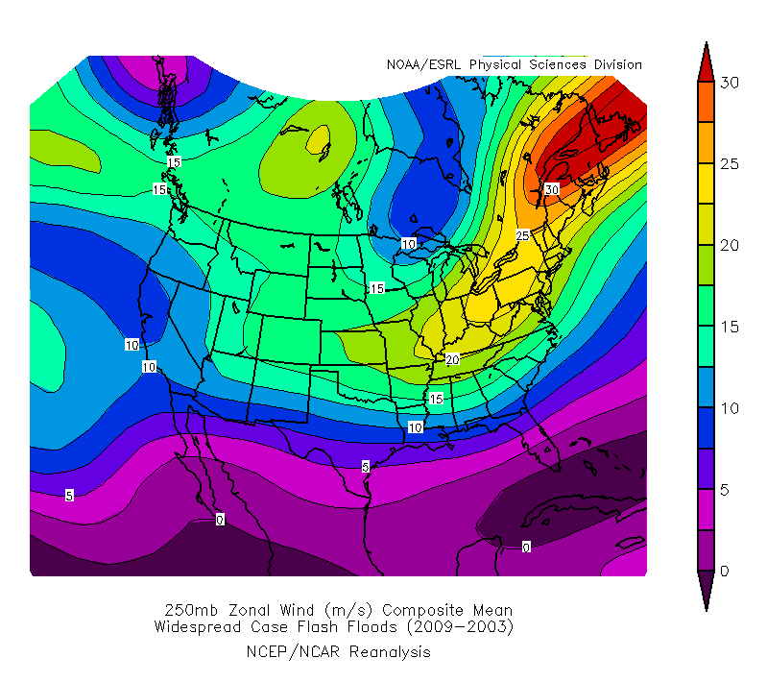
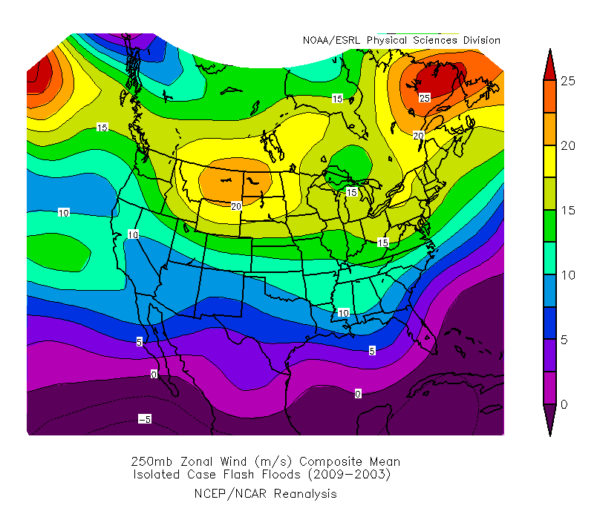
Widespread vs. Isolated FF Comparison
Right Entrance Region of Jet
Right Entrance Region of Jet
250 hPa Zonal Wind Mean

Slide 14
Widespread vs. Isolated FF Comparison
250 hPa Zonal Wind Mean:
Northeast CONUS in pronounced right-entrance region of jet (widespread)
Jet displaced farther north and east and weaker (isolated)

Slide 15
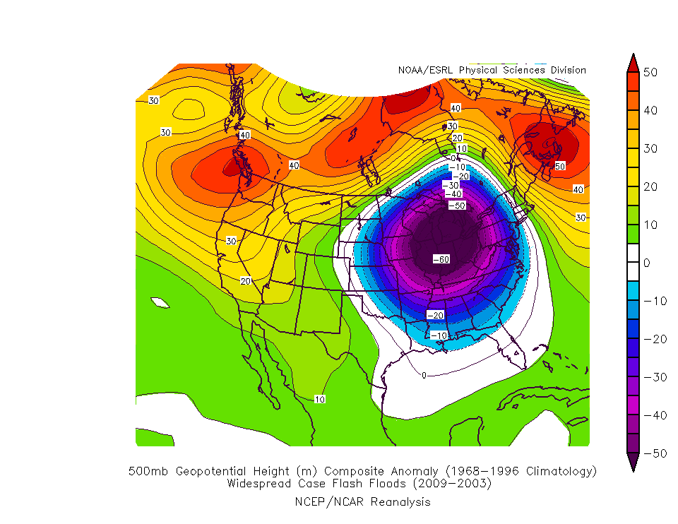
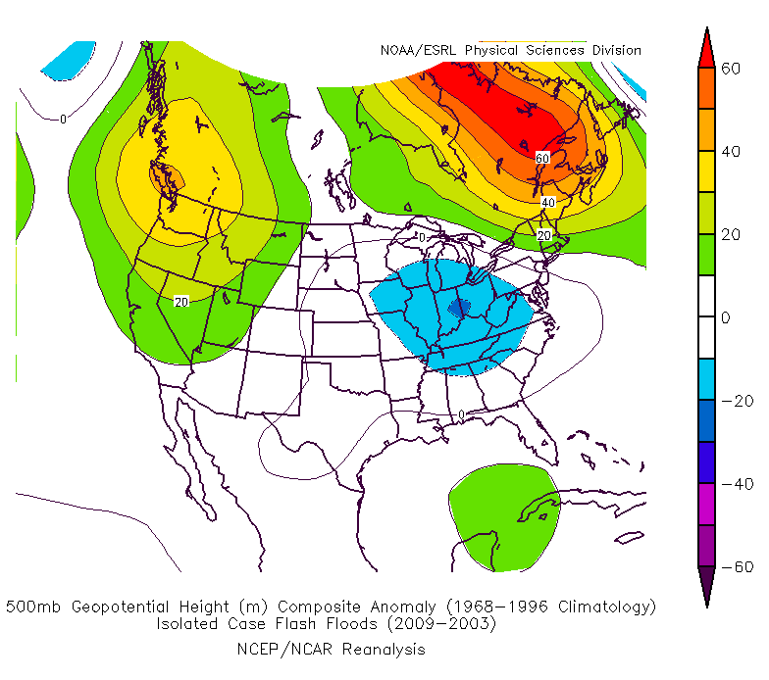
Widespread vs. Isolated FF Comparison
Stronger Negative Height Anomaly
Weaker Negative Height Anomaly
500 hPa Geopotential Height Anomaly

Slide 16
Widespread vs. Isolated FF Comparison
500 hPa Geopotential Height Anomaly:
Much stronger negative anomaly across Great Lakes and Midwest regions (widespread)
Stronger positive anomaly across Canadian Maritimes, Hudson’s Bay and Pacific NW (widespread)

Slide 17
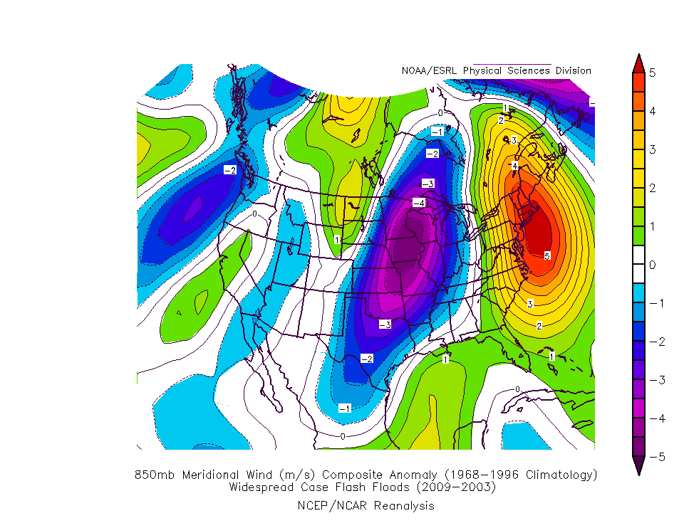
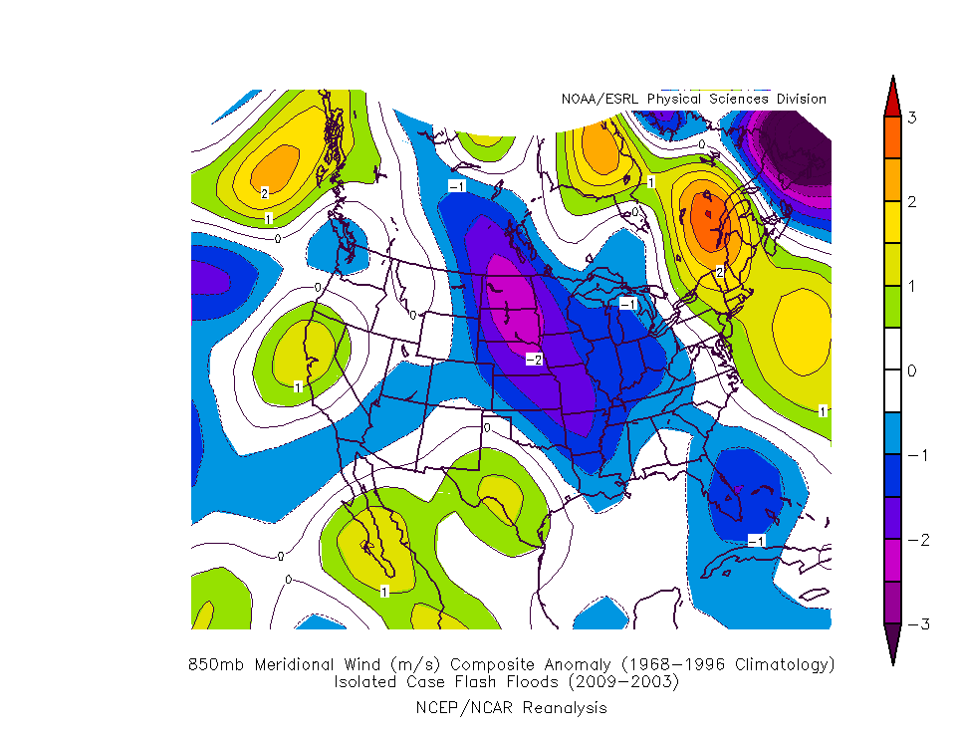
Widespread vs. Isolated FF Comparison
Weaker Meridional Wind Anomaly
Stronger Meridional Wind Anomaly
850 hPa Meridional Wind Anomaly

Slide 18
Widespread vs. Isolated FF Comparison
850 hPa Meridional Wind Anomaly:
Stronger and more expansive positive anomaly (southerly wind component) across Eastern New York into New England (widespread)

Slide 19
Observations/Conclusions
Widespread FF more likely with Cut-off Lows
8 of 12 Cut-off Low events resulted in widespread FF
Most events occurred in June/July and during the afternoon and evening hours

Slide 20
Observations/Conclusions (From Sounding Data)
Most events exhibited veering wind profile in lowest 3 km
Less directional shear for widespread events
Mainly unidirectional flow 3-6 km
“Tall/Skinny” character of CAPE for most events

Slide 21
Observations/Conclusions
Surface dewpoints in the 60s-70s for all events except one
June 15th 2009 dewpoints in the 50s
Almost all cases exhibited positive Theta-E advection at 850 hPa

Slide 22
Observations/Conclusions (Storm Scale)
FF producing cells were either:
Low Echo Centroids – most of significant reflectivity below 0°C level (warm cloud processes resulting in high efficiency rainfall)
Slow-moving cells with taller updrafts (some produced hail and FF)
Training cells (repeatedly moved across the same areas)

Slide 23
Example of LEC
0°C level

Slide 24
Observations/Conclusions
Freezing level and PWAT may be a good indicator FF in general:
Average FZL = 13,200 ft
Average PWAT = 1.68”
However, they do NOT distinguish between isolated/widespread events

Slide 25
Future Work
Look for synoptic features (from composites) when forecasting isolated vs. widespread FF
Develop updated FF checklist for staff at Albany
Investigate hydrologic component of FF?

Slide 26
Acknowledgments
Derek Mallia, University at Albany
Julie Gabriel, University of Delaware
Neil Stuart, NWS Albany

Slide 27
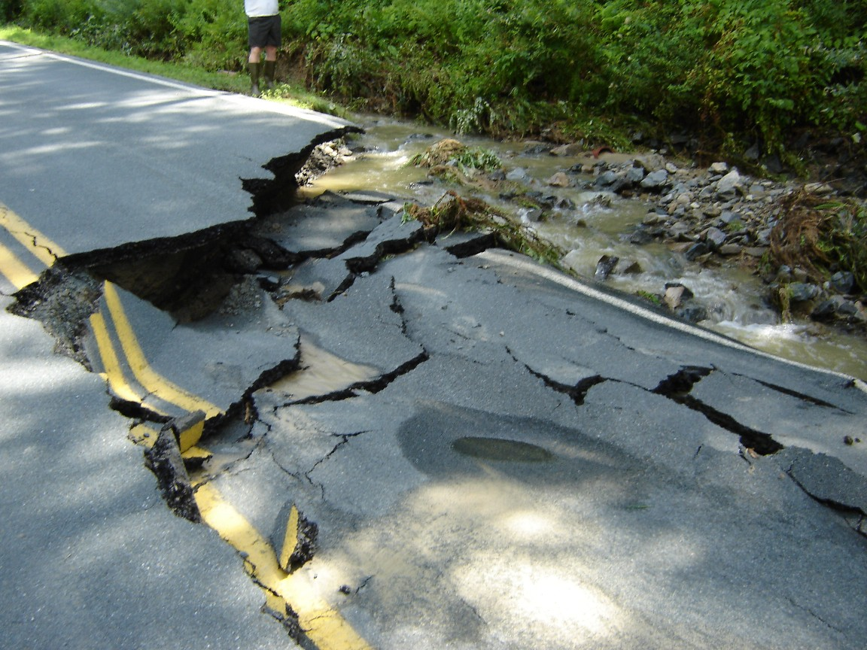
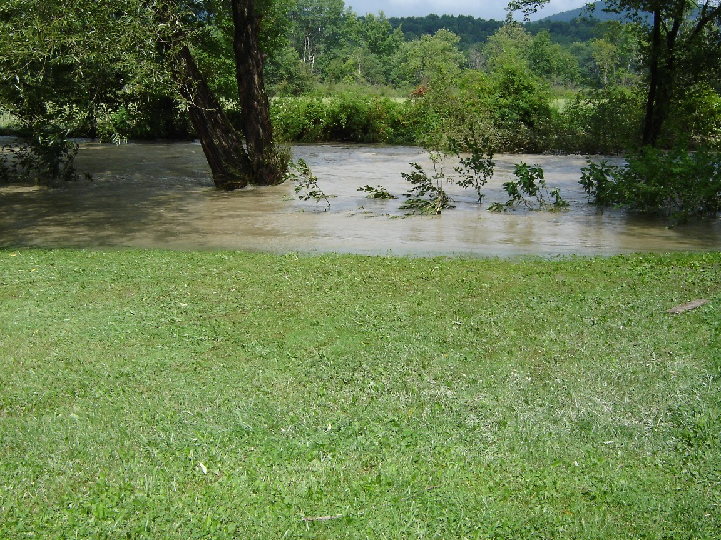
Questions?
Courtesy: Brian Frugis
Joe.Villani@noaa.gov

